Slide 1

Understanding the Ethical Dimensions of Artificial Intelligence
Course: ITAI 2372
Date: 07/16/2025
By: Michel Garcia, Hashim Sayed Hoosini, Miguel Mora

Slide 2

Introduction
Privacy and Bias in Healthcare
Data ownership in Agriculture
AI Transparency and Accountability in Space
AI surveillance & predictive policing in Smart Cities
Misinformation in Entertainment & Media
Data Governance in Blockchain Integration
Social Inequality in Finance
Data Privacy in Retail
Transparency in government & Public sector
Job displacement in Manufacturing
AI and AGI (Artificial General Intelligence )
Technologies that drove the ethical tensions
AI Case Studies
AI Future Trends
Conclusion
Mahatma Gandhi – Civil Rights Activist

Slide 3

AI enhances diagnostics, streamlines patient care, and accelerates drug discovery, but also raises ethical concerns. Issues include Data privacy, biased training data, and a lack of explainability. Responsible AI in healthcare demands transparency, privacy, and strong data governance.
Privacy and Bias in Healthcare

Slide 4

Data ownership in Agriculture
Precision farming using AI enhances yield prediction and resource management, but can marginalize small-scale farmers who lack access to technology.
Ethical challenges include data ownership, algorithmic control over land decisions, and potential ecological harm from over-optimization.
Equity in digital agriculture is key to inclusive food futures.
Gustav Flaubert – French Novelist

Slide 5

AI Transparency and Accountability in Space
AI supports autonomous spacecraft navigation, planetary data analysis, and mission design; however, its use also raises concerns about dual-use applications.
Space AI may fuel surveillance or militarization, with ethical dilemmas around transparency and peaceful use.
Global frameworks must guide responsible innovation beyond Earth.
Isabel Allende – Chilean Author

Slide 6
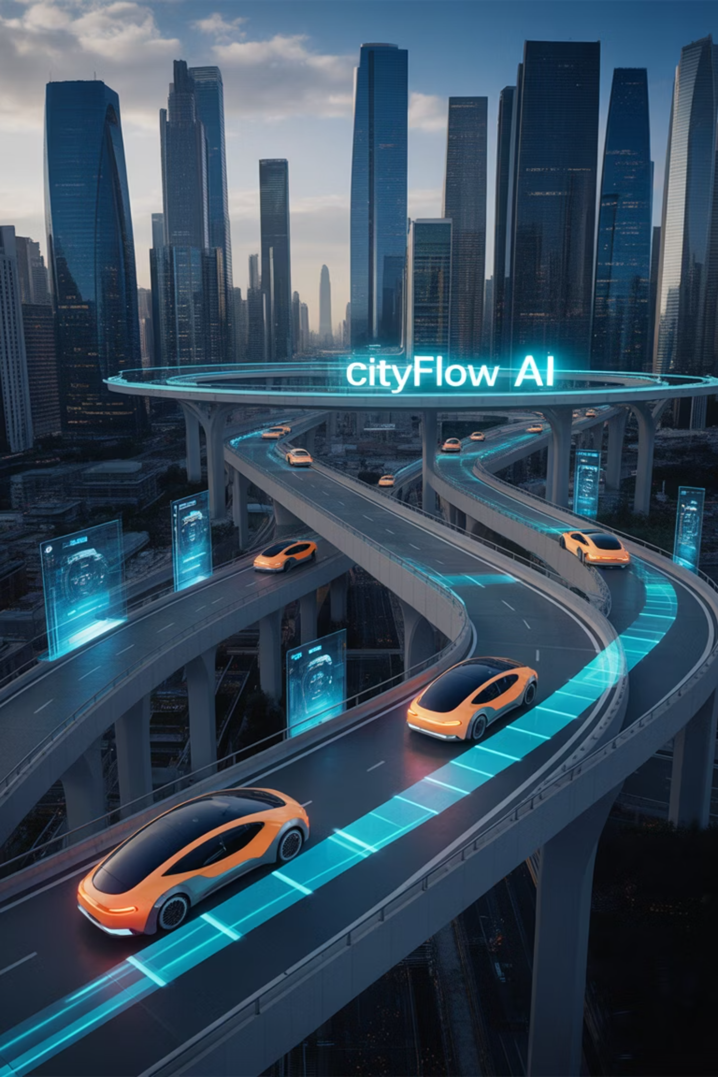
AI surveillance & predictive policing in Smart Cities
AI optimizes traffic flow, utilities, and urban planning, but widespread surveillance and automated decision-making threaten privacy and civic agency.
Predictive policing and intelligent monitoring must be examined and observed for bias and accountability.
Ethical urban AI must center citizen rights and participatory governance.

Slide 7

Misinformation in Entertainment & Media
AI generates deepfakes, curates content, and simulates creative output.
AI promises personalization and new art forms, but it also fuels misinformation and erodes trust in media authenticity.
Ethical media AI must address consent, intellectual ownership, and digital manipulation.

Slide 8

Data Governance in Blockchain Integration
Combining AI’s predictive power with blockchain’s transparency offers promise but introduces ethical tensions.
Ethical questions such as "Who governs hybrid systems?" Or "Is decentralized AI truly accountable? " begins to arise.
Use cases like supply chain integrity or AI model validation require rigorous policy frameworks to avoid tech determinism.

Slide 9
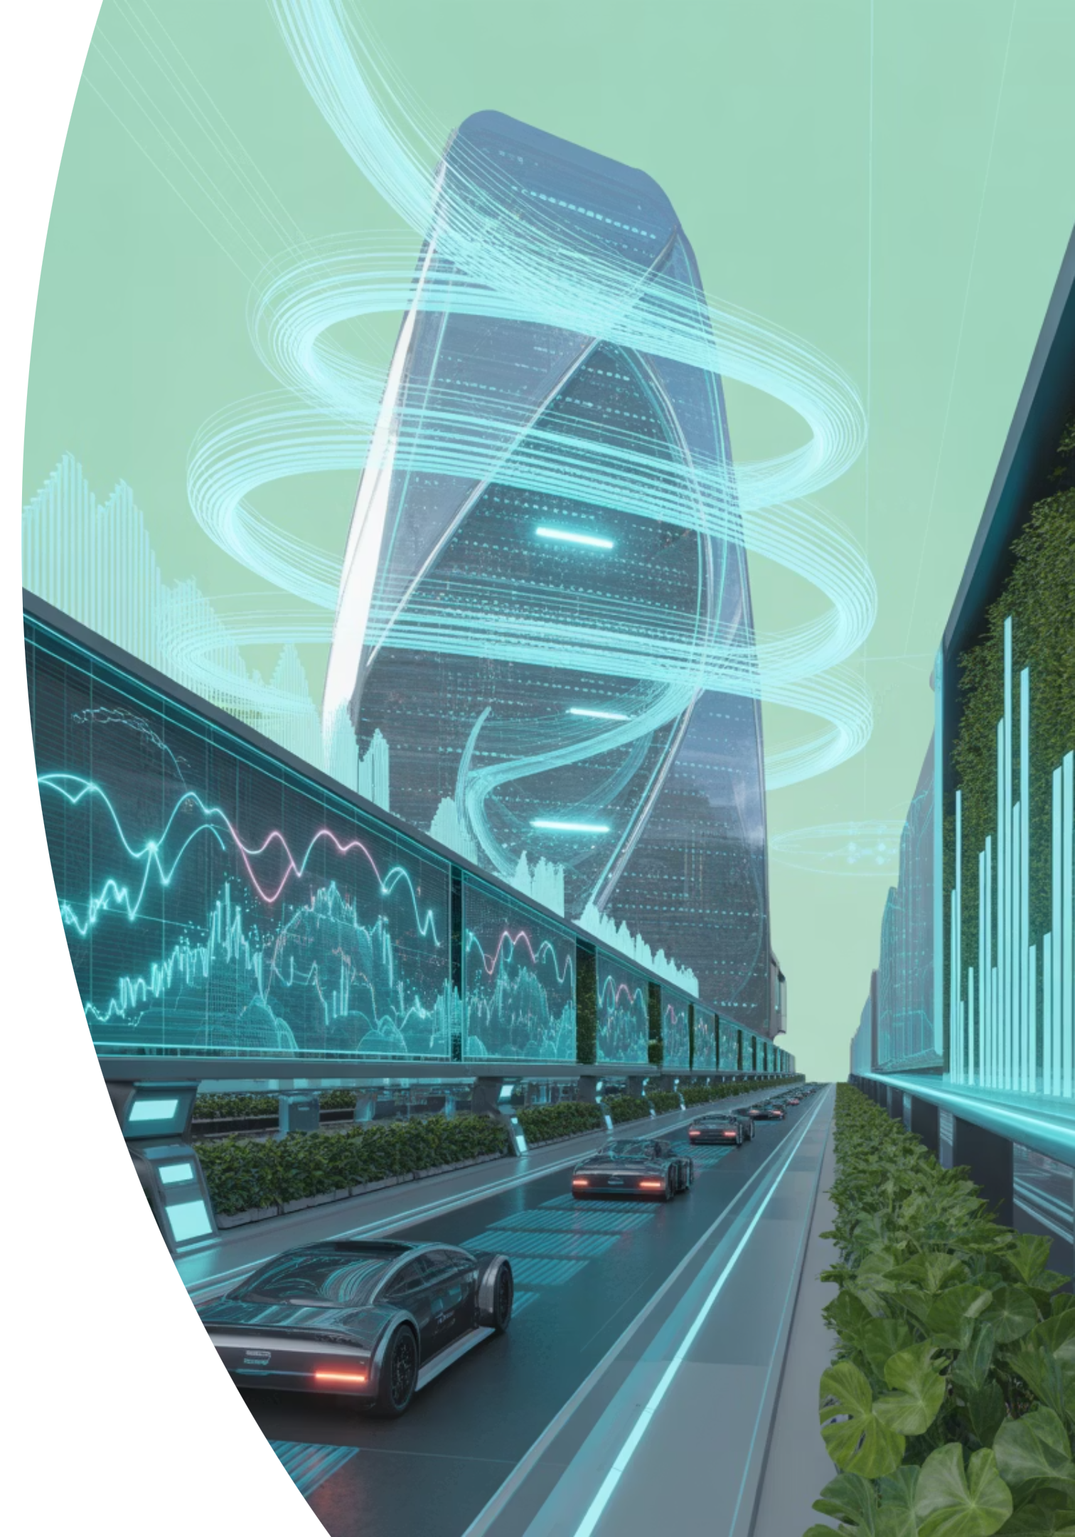
Social Inequality in Finance
AI-driven trading, lending, and risk profiling enhance efficiency but can exacerbate bias and erode financial inclusion.
Credit scoring algorithms may reflect societal inequities; blurred systems pose risks of systemic unfairness.
Ethical finance AI must prioritize explainability, fairness, and regulatory oversight.

Slide 10

Data Privacy in Retail
AI personalizes shopping, forecasts demand, and optimizes inventory, while also monitoring customer behavior and nudging customers toward preferred choices.
Ethical questions arise around consumer manipulation, data consent, and labor automation.
Responsible retail AI should protect privacy and support fair labor practices.

Slide 11
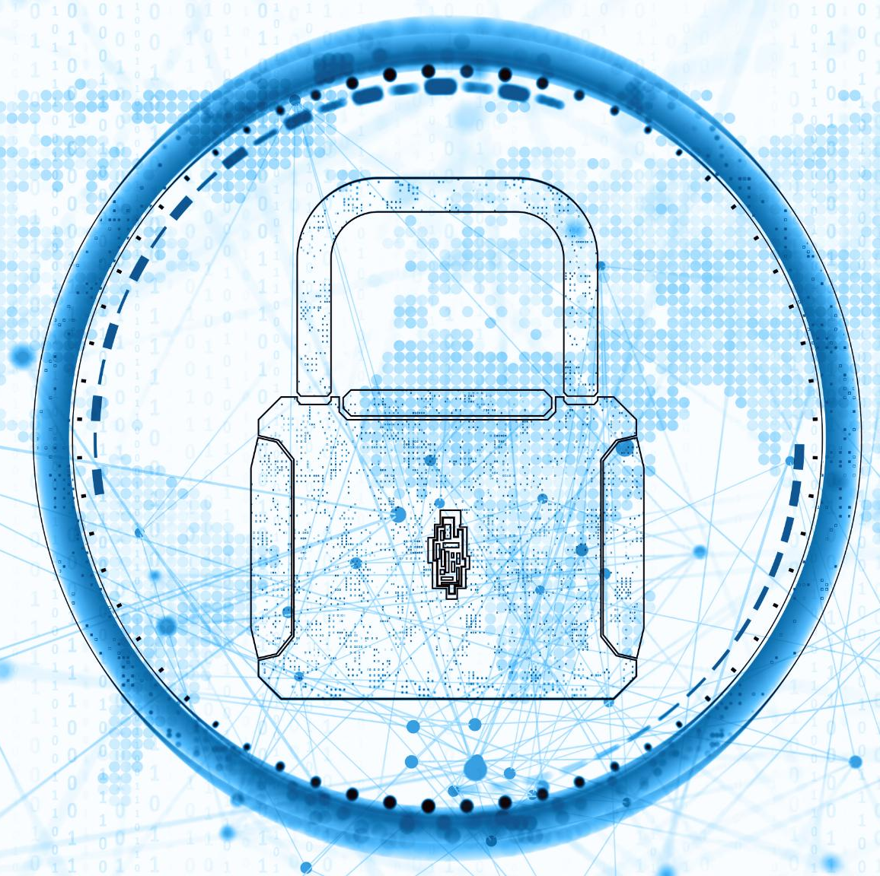
Transparency in Government & Public sector
AI supports public service delivery, disaster response, and resource allocation.
Deployment can establish bureaucratic obscurity, algorithmic bias in welfare or legal decisions, and surveillance.
Governments must ensure transparency, due process, and citizen oversight.

Slide 12
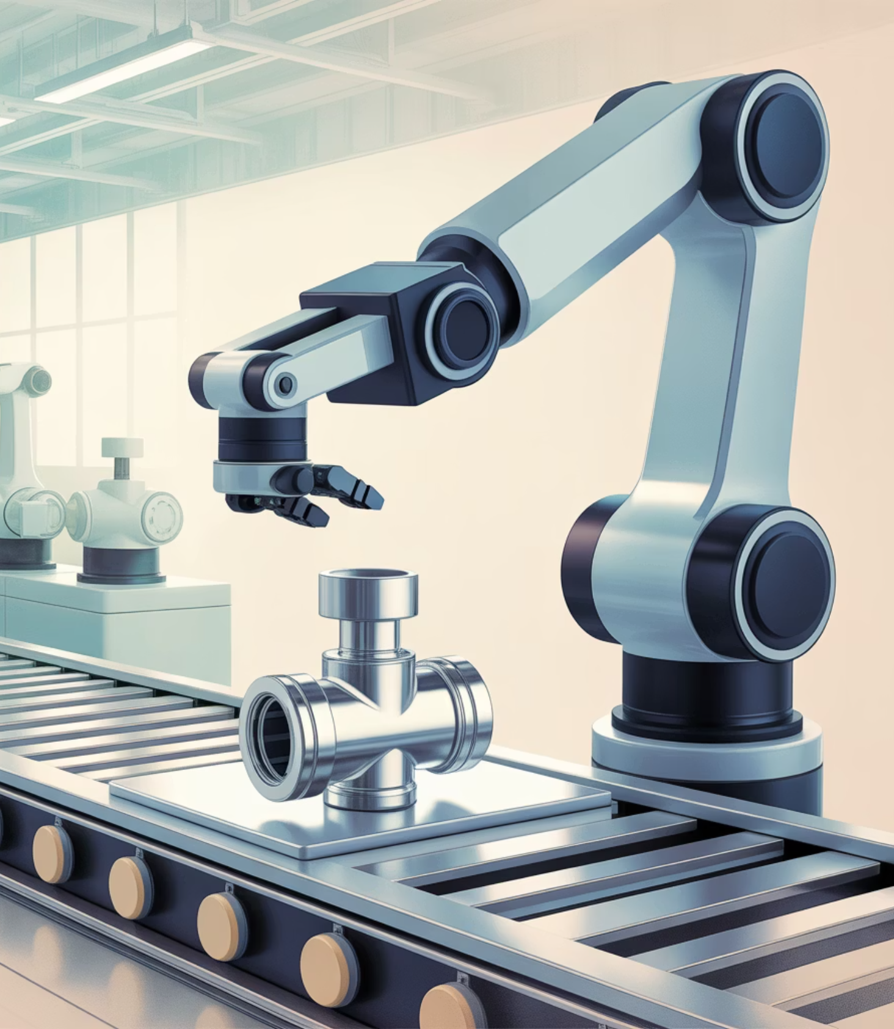
Job Displacement in Manufacturing
AI enhances automation, predictive maintenance, and safety, but displaces workers and alters labor dynamics.
Ethical concerns include job displacement without adequate reskilling and the potential for worker surveillance.
Responsible adoption involves labor-inclusive planning and human-centered design.

Slide 13
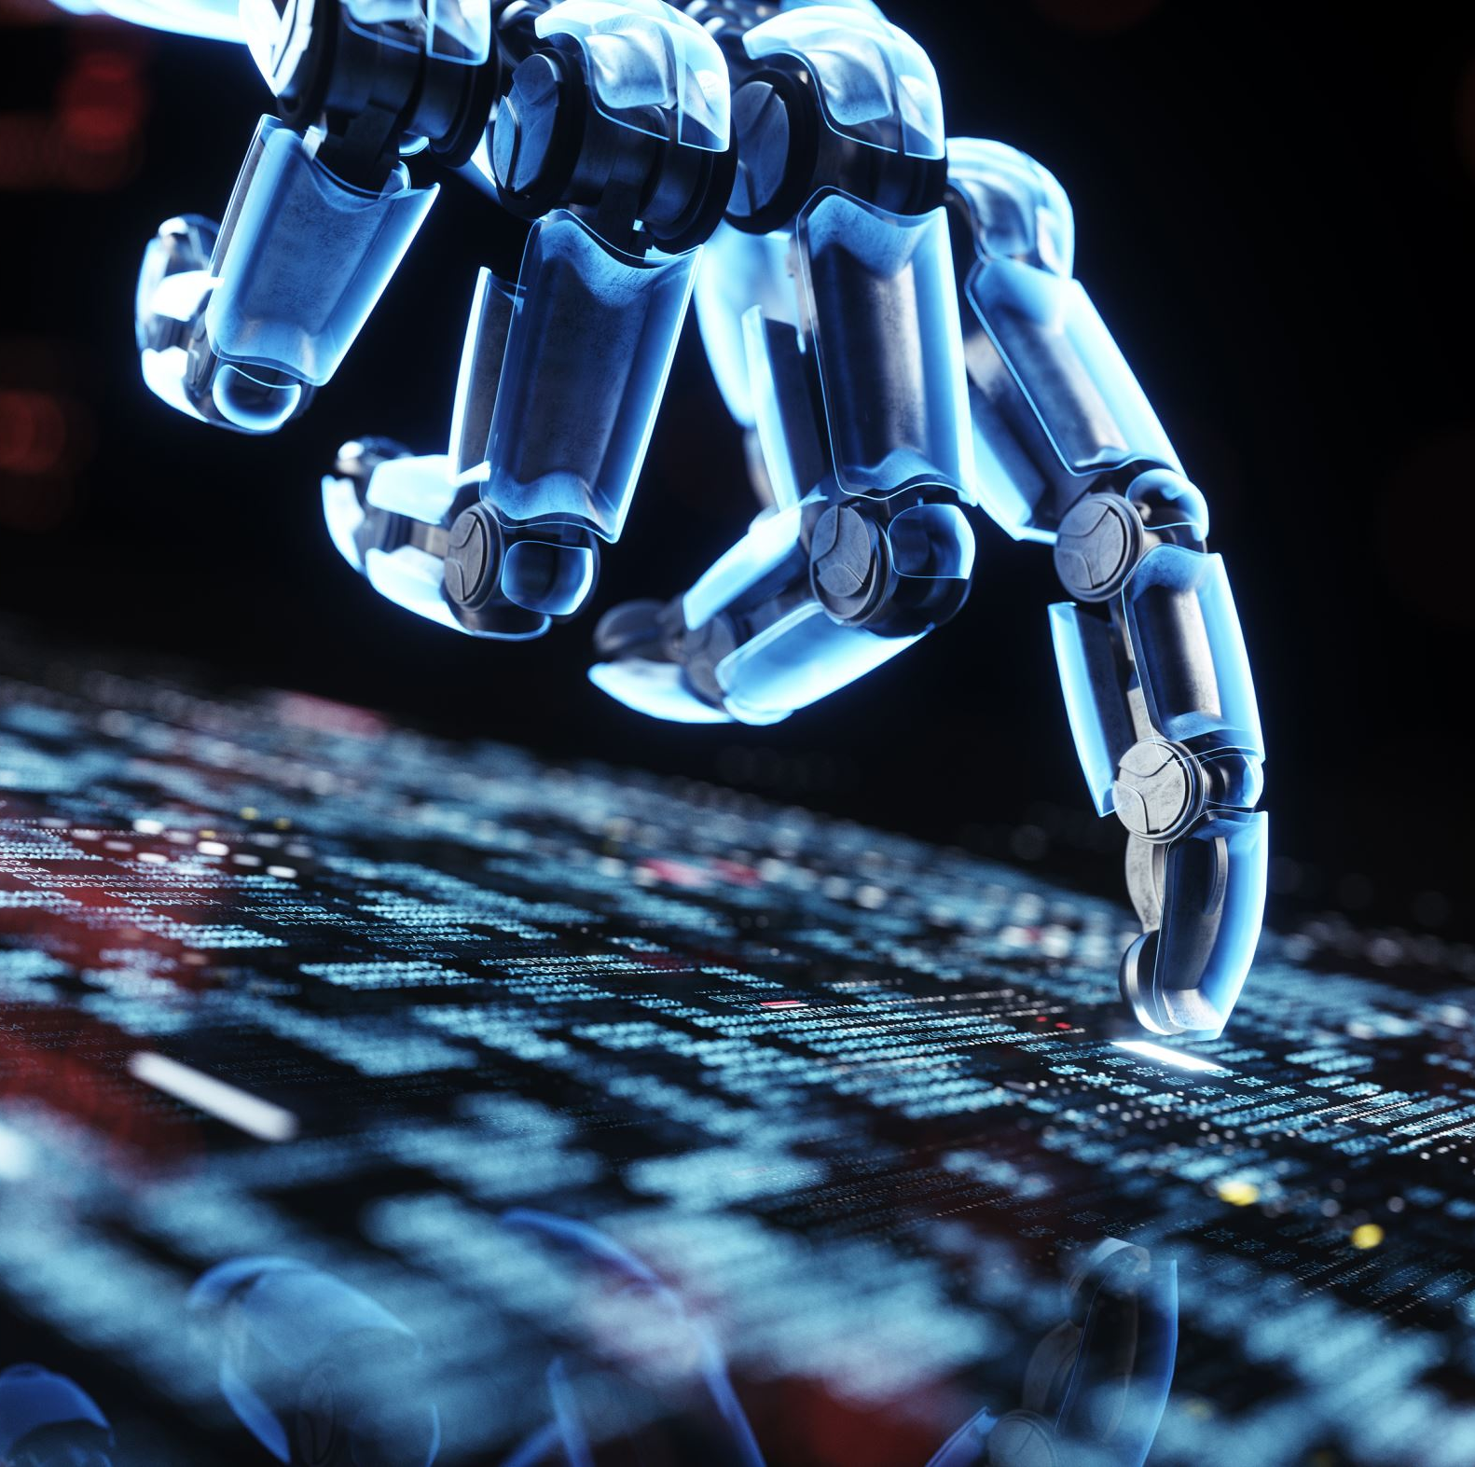
AI and AGI (Artificial General Intelligence)
AGI represents a frontier with undefined capabilities and uncertain impact.
Evolution raises profound ethical questions: whose values guide it, can it be controlled, and what happens when its goals depart from human intentions?
Governance for AGI must be global, proactive, and morally pluralistic.

Slide 14


Technologies Driving Ethical Tensions
NLP in content moderation
Facial recognition and surveillance
Lack of explainability in large models
Natural Language Processing (NLP) is used in platforms like YouTube and Twitter to detect hate speech and misinformation. However, these systems must balance content filtering with freedom of speech and avoid cultural or linguistic biases.
Convolutional Neural Networks (CNNs) power facial recognition technologies used in surveillance and law enforcement. These systems can misidentify individuals, especially from minority groups, raising ethical concerns about racial profiling and abuse of power.
Many modern AI models, such as deep neural networks, are considered black boxes. Their lack of transparency makes it difficult to understand or justify decisions, which is problematic in sensitive fields like healthcare or criminal justice.

Slide 15


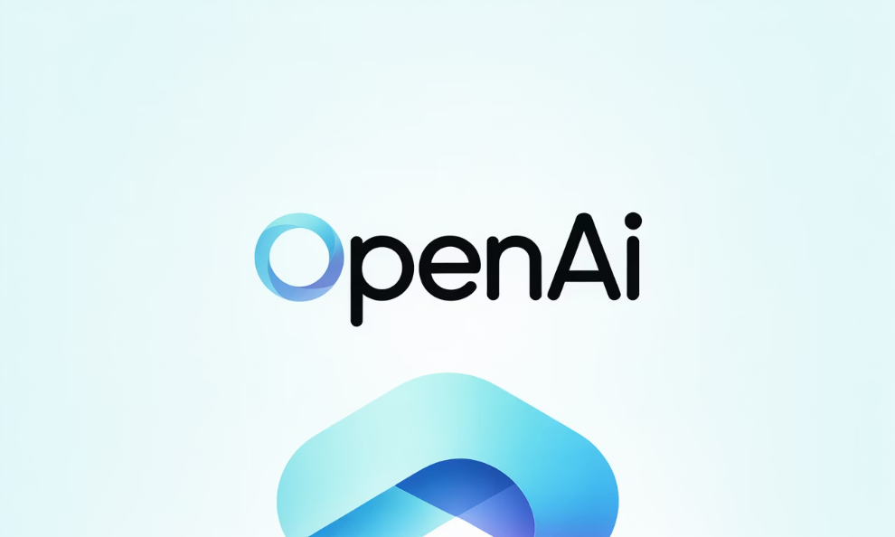
Case studies
Amazon hiring tool bias
Predictive policing concerns
ChatGPT is generating fake legal citations.
Amazon's AI tool trained on ten years of resumes favored male applicants, penalizing resumes with terms like "women's chess club." This incident highlighted how biased training data can perpetuate institutionalized discrimination.
AI-driven predictive policing tools have faced criticism for reinforcing systemic biases when based on historically skewed crime data. This leads to over-policing in specific communities and undermines public trust.
Instances of ChatGPT generating non-existent legal cases have raised concerns in the legal community. Without clear boundaries and verification, AI can inadvertently spread misinformation and create legal liability.

Slide 16
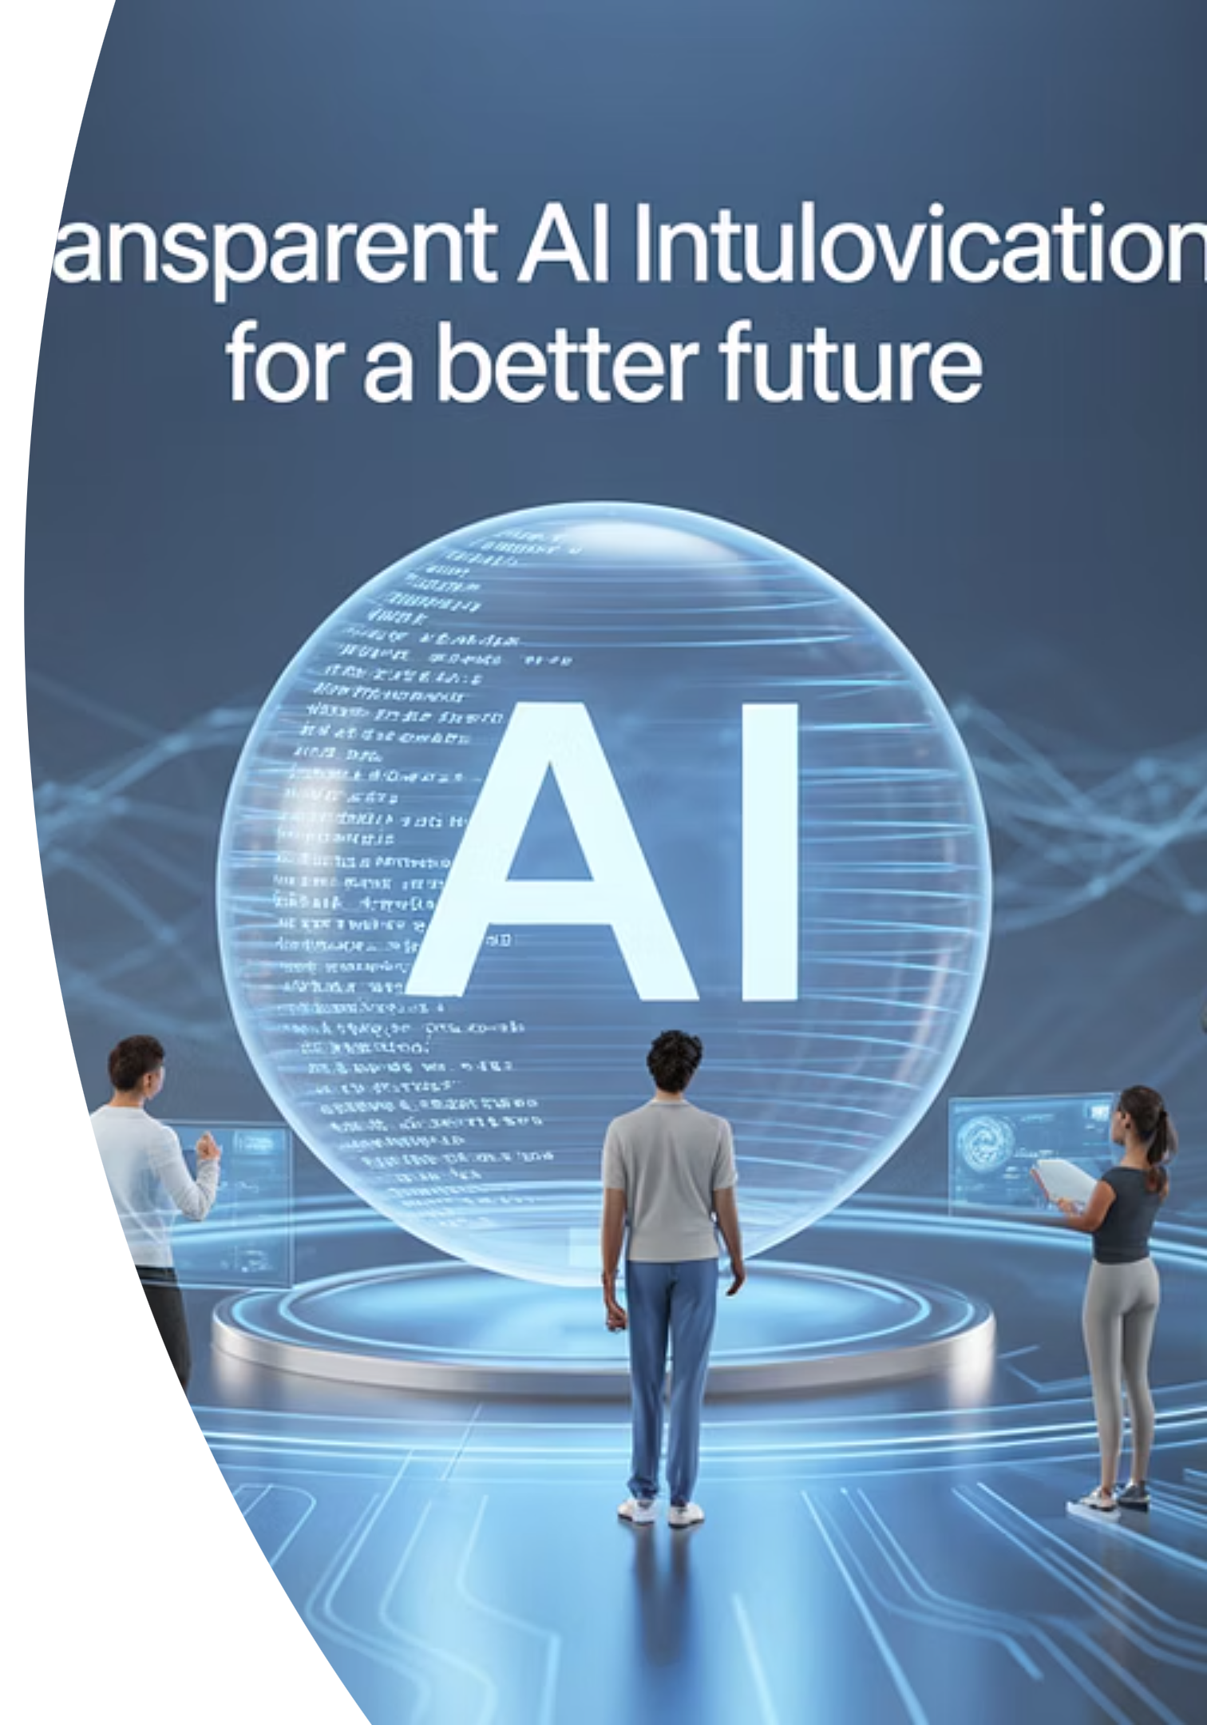




What's Ahead: Ethical AI Innovations
Federated Learning
Federated learning allows AI to train on decentralized data while protecting user privacy and improving model performance without centralizing sensitive information.
AI for Social Good
AI is being used to tackle global challenges like poverty, climate change, and disability access. These applications demonstrate AI's potential for positive impact.
Responsible AI frameworks
Tech companies like Microsoft and Google are establishing internal ethics boards and releasing guidelines for the responsible use of AI.
Trends: Explainable & Multimodal AI
Future systems aim to justify decisions and handle text, image, and video data, making AI more versatile and user-aware.

Slide 17
Conclusion
Artificial intelligence continues to transform nearly every sector – offering remarkable potential to improve healthcare , agriculture, finance, government, and beyond.
Issue such as bias, surveillance, inequality, and lack of transparency must be addressed through thoughtful design and inclusive policy.
To ensure a just future, Ai must be developed with fairness, accountability, and human values at its core.
Ethical AI is not just a technical goal; it is a societal commitment.

Slide 18
References
Ethics guidelines for trustworthy AI - European Parliament. (n.d.). https://www.europarl.europa.eu/cmsdata/196377/AI HLEG_Ethics Guidelines for Trustworthy AI.pdf
World Health Organization. (n.d.). Who releases AI ethics and governance guidance for large multi-modal models. World Health Organization. https://www.who.int/news/item/18-01-2024-who-releases-ai-ethics-and-governance-guidance-for-large-multi-modal-models
https://www.govloop.com/community/blog/ai-and-the-public-sector-navigating-ethics-and-innovation-by-2030/
https://www.reedsmith.com/en/perspectives/ai-in-entertainment-and-media/2023/06/ai-ethics
NASA. (2025, January 14). NASA’s AI use cases: Advancing Space Exploration with responsibility . NASA. https://www.nasa.gov/organizations/ocio/dt/ai/2024-ai-use-cases/
https://www.who.int/publications/i/item/9789240029200
https://www.cgiar.org/news-events/news/ai-sparks-a-new-agricultural-revolution-in-the-global-south/
https://www.nasa.gov/directorates/spacetech/ai-use-cases-in-space-exploration
https://www.imf.org/en/Publications/fandd/issues/2023/09/AI-reverberations-across-finance
https://unhabitat.org/topic/artificial-intelligence
https://www.brookings.edu/articles/the-ethics-of-ai-generated-content/
https://www.nist.gov/publications/artificial-intelligence-fraud-detection
https://www.technologyreview.com/2023/05/01/1072187/ai-blockchain-convergence/
https://www2.deloitte.com/us/en/pages/consumer-business/articles/ai-in-retail.html
https://www.oecd.org/governance/ai-in-the-public-sector/
https://www.mckinsey.com/business-functions/operations/our-insights/how-ai-is-transforming-manufacturing
https://futureoflife.org/open-letter/pause-giant-ai-experiments/

